Slide 1
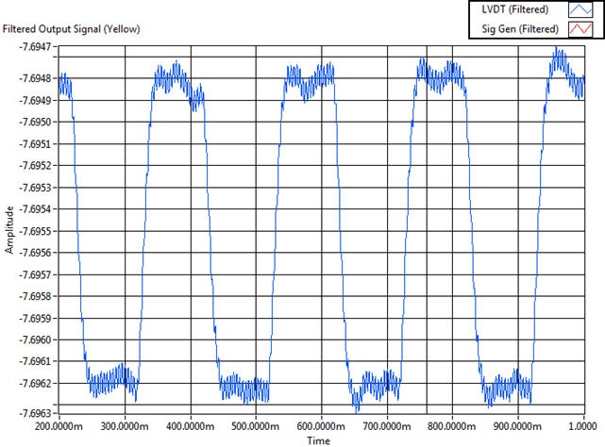
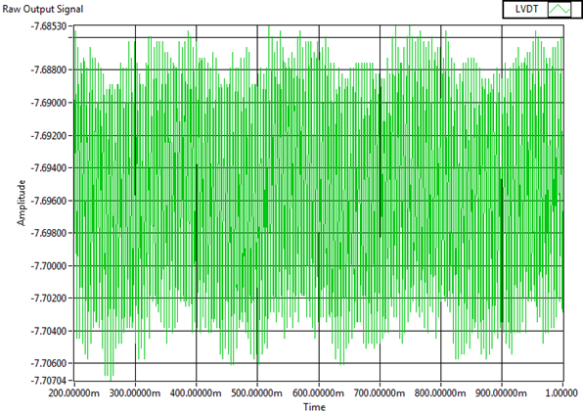
Sensors and Data
Results
Focus was on windowing and signal processing
Used Fourier Transform to find constituent frequencies of measured signal
Various waveforms
Various sampling frequencies

